Slide 1
Enterprise Scale Azure Kubernetes Service
Author
Date

Slide 2
The elements of high-performing Kubernetes
Kubernetes
Scheduling
Affinity/ anti-affinity
Health monitoring
Failover
Scaling
Networking
Service discovery
Coordinated app upgrades
Notes:
Affinity/anti-affinity rules provide instructions to the scheduler on considerations for scheduling a pod
e.g.
Affinity rule: Locate a new pod on a node which has a pod already running with particular labels
An anti-affinity rule: Do not place the pod on a node which has a pod with certain labels
Affinity rules can be required, or preferred.

Slide 3
Build on an enterprise-grade, secure platform
Control access through AAD and RBAC
Get runtime vulnerability scanning and auditing through Azure Security Center
Put guardrails in your development process with Azure Policy
Secure network communications with VNET and network policy
Gain automated threat protection and best practice recommendations for Kubernetes clusters

Slide 4

AKS Landing zone accelerator
A modular approach that allows you to customize your environment variables
Design guidelines for evaluating critical decisions
The landing zone architecture
Microsoft recommended AKS reference implementation on the AKS baseline (https://learn.microsoft.com/en-us/azure/architecture/reference-architectures/containers/aks/secure-baseline-aks)
Reference implementation https://aka.ms/aks-reference-implementation

Slide 5
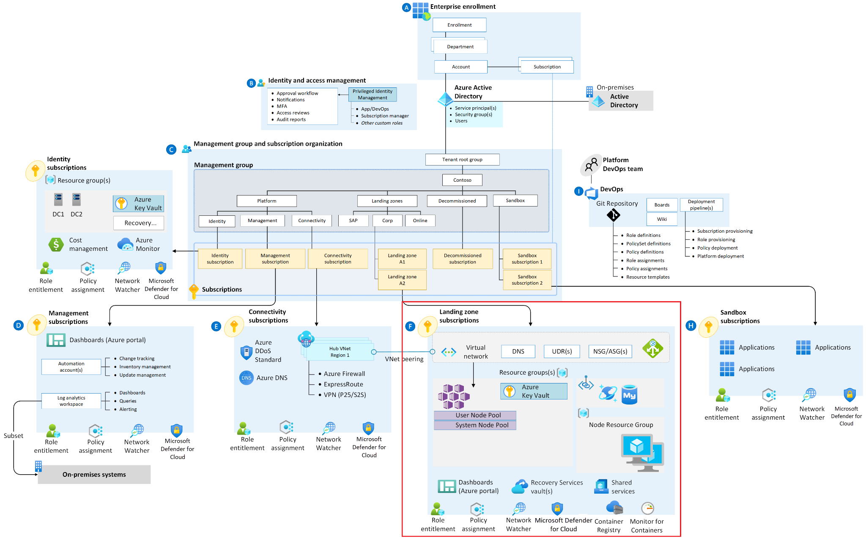
Example conceptual reference architecture

Slide 6
AKS baseline for microservices

Slide 7
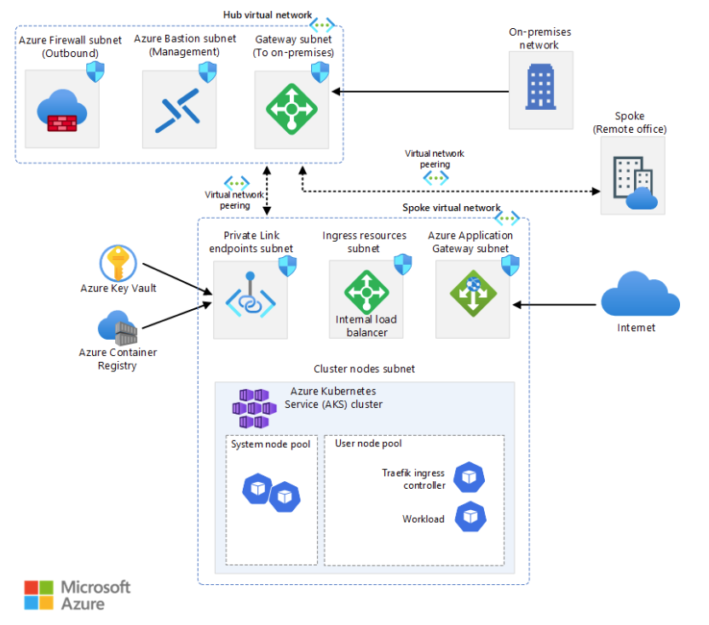
Architecture – AKS baseline
Notes:
mspnp/aks-fabrikam-dronedelivery: AKS Fabrikam Drone Delivery AKS baseline (github.com)

Slide 8
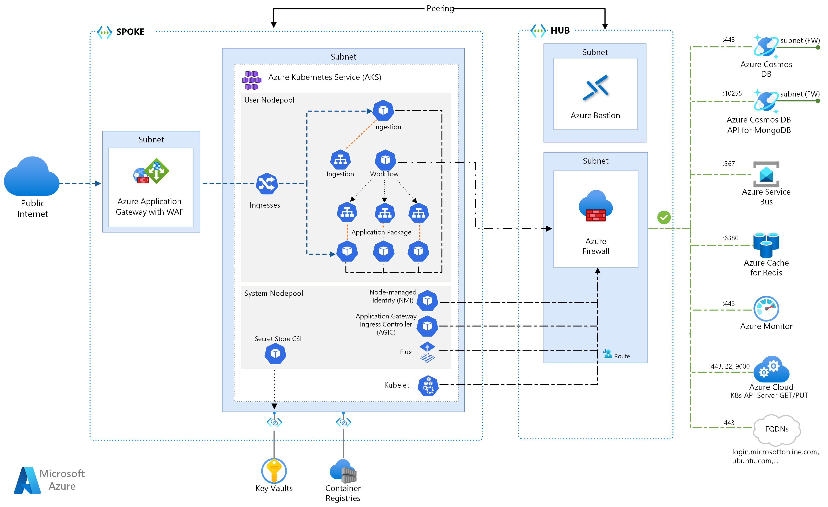
Architecture – AKS baseline for microservices
Notes:
mspnp/aks-fabrikam-dronedelivery: AKS Fabrikam Drone Delivery AKS baseline (github.com)

Slide 9
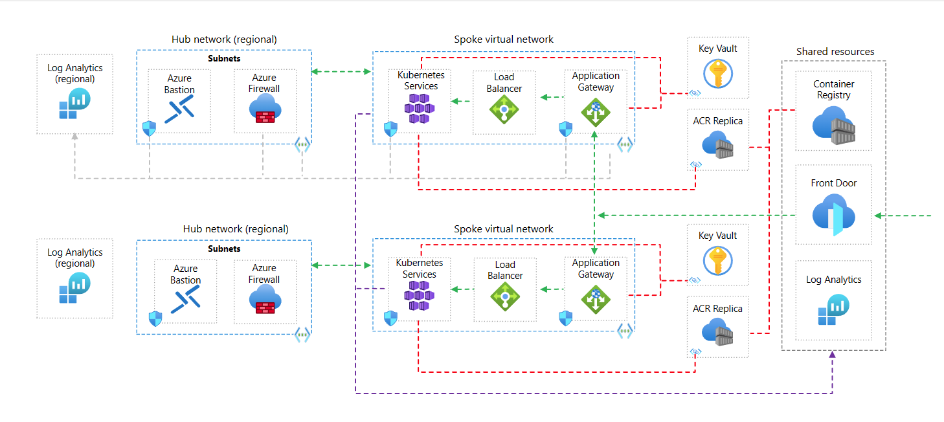
Architecture – AKS baseline for multi-region clusters
Notes:
mspnp/aks-baseline-multi-region: This is the Azure Kubernetes Service (AKS) baseline for multi-region reference implementation as produced by the Microsoft Azure Architecture Center. (github.com)

Slide 10
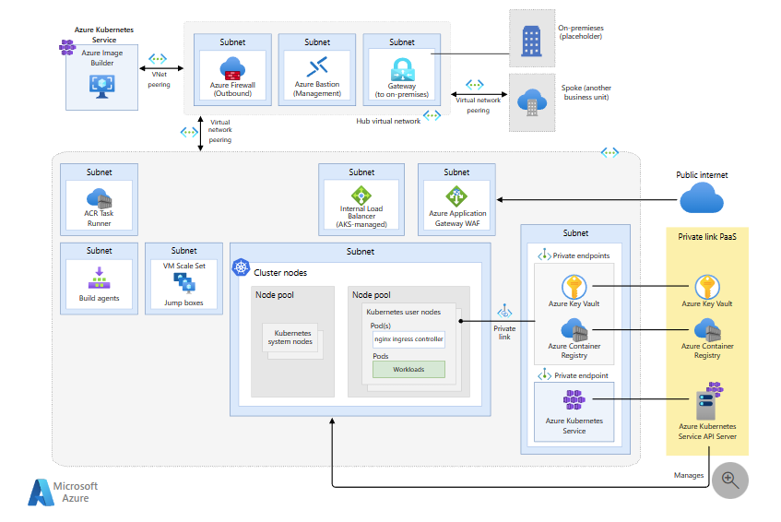
Architecture – AKS regulated cluster for PCI-DSS 3.2.1
Notes:
https://github.com/mspnp/aks-baseline-regulated

Slide 11
Considerations / Recommendations

Slide 12

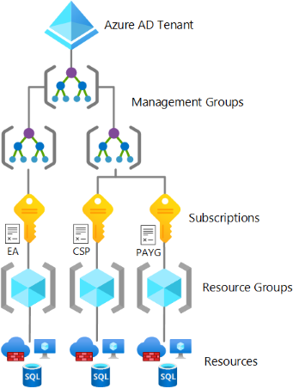
Consideration: Azure Billing and AAD tenant
Will the landing zone or Kubernetes hosts be used as part of clean-room development?
Are there heightened compliance requirements, which specify separation of duties between the people operating the host and the accounts that operate the landing zone environment?
In a centrally managed environment with multiple hosts in a single landing zone, is there a need for extended blast radius control for compromised identities?
Notes:
Most customers will identify their primary Azure AD tenant as their Kubernetes role-based access control (RBAC) Azure AD tenant. But, Kubernetes allows for different elevations of RBAC management. There are situations where you might want to establish a different Kubernetes RBAC Azure AD tenant from the tenant, which governs identity for the landing zone. This can lead to some specific considerations when establishing Azure landing zones for AKS. The following are indicators that might lead you to consider this alternative approach to tenant assignment:
Will the landing zone or Kubernetes hosts be used as part of clean-room development?
Are there heightened compliance requirements, which specify separation of duties between the people operating the host and the accounts that operate the landing zone environment?
In a centrally managed environment with multiple hosts in a single landing zone, is there a need for extended blast radius control for compromised identities?
Managing multiple Azure AD tenants comes at a management cost that must be weighed against the benefits gained from such a topology. There are seldom cases with multiple tenants would be part of any Microsoft recommendation. But the above questions could indicate a need to consider this option.

Slide 13

Consideration: Identity and access management
Decide which cluster identity to use (managed identity or service principal).
Decide how to authenticate cluster access
Decide on a multitenancy cluster and how to set up RBAC
Determine the permissions for custom Azure RBAC roles – SRE, SecOps, Landing Zone Owner, App Teams
Decide whether you need workload identities (Azure AD workload identities)
Notes:
Decide which cluster identity to use (managed identity or service principal).
Decide how to authenticate cluster access: based on client certificates or via Azure Active Directory (Azure AD).
Decide on a multitenancy cluster and how to set up role-based access control (RBAC) in Kubernetes.
Choose a method for isolation. Methods include namespace, network policy (Only allowed by Azure CNI), compute (node pool), and cluster.
Determine the Kubernetes RBAC roles and compute allocation per application team, for isolation.
Decide whether application teams can read other workloads in their clusters or in other clusters.
Determine the permissions for custom Azure RBAC roles for your AKS landing zone.
Decide what permissions are needed for the site reliability engineering (SRE) role to enable that role to administer and troubleshoot the whole cluster.
Decide what permissions are needed for SecOps.
Decide what permissions are needed for the landing zone owner.
Decide what permissions the application teams will need to deploy into the cluster.
Decide whether you need workload identities (Azure AD workload identities). You might need them for services like Azure Key Vault integration and Azure Cosmos DB.

Slide 14
Recommendations: Identity and access management
Cluster identities (managed identity and custom Azure RBAC)
Cluster access (K8S RBAC with Azure AD to limit admin access and AKS Azure AD integration for dev or operator access)
Define required RBAC roles and role bindings in Kubernetes.
Grant SRE full access just-in-time, as needed (Azure AD PIM and identity access mgt)
Use Azure AD workload identity for Kubernetes.
Notes:
Cluster identities.
Use your own managed identity for your AKS cluster.
Define custom Azure RBAC roles for your AKS landing zone to simplify the management of required permissions for cluster-managed identity.
Cluster access.
Use Kubernetes RBAC with Azure AD to limit privileges and minimize administrator privileges. Doing so helps to protect configuration and secrets access.
Use AKS-managed Azure AD integration so you can use Azure AD for authentication and operator and developer access.
Define required RBAC roles and role bindings in Kubernetes.
Use Kubernetes roles and role bindings to Azure AD groups for site reliability engineering (SRE), SecOps, and developer access.
Consider using Azure RBAC for Kubernetes, which enables unified management and access control across Azure resources, AKS, and Kubernetes resources. When Azure RBAC for Kubernetes is enabled, you don't need to separately manage user identities and credentials for Kubernetes. Azure AD principals will be exclusively validated by Azure RBAC, but regular Kubernetes users and service accounts will be exclusively validated by Kubernetes RBAC.
Grant SRE full access just-in-time, as needed.
Use Privileged Identity Management in Azure AD and identity and access management in Azure landing zones.
Use Azure AD workload identity for Kubernetes. When you implement this federation, developers can use native Kubernetes service accounts and federation to access resources managed by Azure AD, like Azure and Microsoft Graph.

Slide 15

Considerations: Network topology and connectivity (1/2)
Decide between two networking models: kubenet and Azure Container Networking Interface (CNI).
Carefully plan to support the scaling of the cluster
Consider having virtual nodes for quick cluster scaling with virtual kubelet
Decide between Basic and Standard Azure Load Balancer SKUs (public or internal load balancer)
Use Azure Policy and the Azure Policy add-on for AKS to control and limit the objects created
Check CoreDNS to understand name resolution to pods
Notes:
Decide between two networking models: kubenet and Azure Container Networking Interface (CNI).
CNI requires extra planning for IP addresses.
Only CNI supports Windows Server node and network policies pool.
UDR for kubenet is automatically set up by AKS.
kubenet only supports up to 400 nodes.
Verify the current list of capabilities supported by each CNI plug-in.
IP addressing and the size of the virtual network subnet must be carefully planned to support the scaling of the cluster. For example, you can add more nodes.
Virtual nodes can be used for quick cluster scaling, but there are some known limitations.
AKS clusters support Basic and Standard Azure Load Balancer SKUs.
AKS services can be exposed with public or internal load balancers. Internal load balancers can be configured in the same subnet as the Kubernetes nodes or in a dedicated subnet.
Azure Policy and the Azure Policy add-on for AKS can control and limit the objects created in your AKS cluster, such as denying the creation of services with a public load balancer.
AKS uses CoreDNS to provide name resolution to pods running in the cluster.
CoreDNS will resolve cluster-internal domains directly.
Other domains will be forwarded to the DNS servers configured in Azure Virtual Network, which will be either the default Azure DNS resolver, or any custom DNS servers configured at the virtual network level.

Slide 16
Considerations: Network topology and connectivity (2/2)
Outbound (egress) network traffic can be sent through an Azure Firewall or network virtual appliance cluster (Load Balancer and UDR)
Use Network policies to improve security and filter network traffic.
A service mesh provides capabilities like traffic management, resiliency, policy, security, strong identity, and observability. For more information, see the selection criteria.
Increase resiliency with Azure Traffic Manager and Azure Front Door.
Don't manually edit generated NSG – influence it by configuring the services you deploy in AKS.
Notes:
Outbound (egress) network traffic can be sent through an Azure Firewall or network virtual appliance cluster.
By default, AKS clusters have unrestricted egress internet access.
There are two deployment models for outbound connectivity: LoadBalancer or UserDefinedRouting (UDR). With UDR, there's no public IP address created in the cluster for egress traffic. This is especially important when deploying an AKS cluster to a Corp subscription with a policy to forbid creation of a public IP address. For more information, see Policies included in reference implementations of enterprise-scale landing zones.
Egress traffic from the AKS cluster can be sent through Azure Firewall or a network virtual appliance cluster by configuring UDRs in the AKS subnet.
If using outbound mode loadBalancer, you must carefully manage outbound ports, since you might use up the available outbound ports.
By default, all pods in an AKS cluster can send and receive traffic without limitations. Kubernetes network policies can be used to improve security and filter network traffic between pods in an AKS cluster. Two network policy models are available for AKS. Azure network policies are fully supported by Microsoft, while Calico is an open-source network security solution with more features and is also recommended.
A service mesh provides capabilities like traffic management, resiliency, policy, security, strong identity, and observability. For more information, see the selection criteria.
Global load-balancing mechanisms such as Azure Traffic Manager and Azure Front Door increase resiliency by routing traffic across multiple clusters, potentially in different Azure regions.
AKS sets up a network security group (NSG) on the subnet in which the cluster is deployed. Don't manually edit this NSG, but you can influence by configuring the services you deploy in AKS.

Slide 17
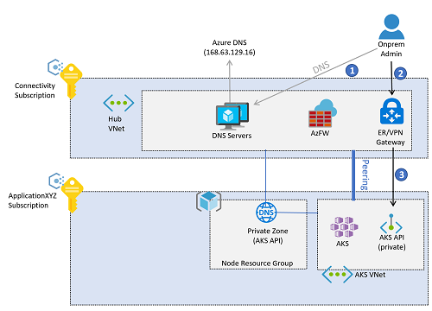
Considerations: Private clusters (1/2)
Use custom private DNS zones rather than letting the creation process use a system private DNS zone
Use Azure Container Networking Interface (CNI) as a network model
Use Azure DDoS Protection Standard to protect the virtual network (unless you use Azure Firewall or WAF in a centralized subscription)
Use the DNS configuration linked to the overall network setup
Use Private Link to secure network connections
Use an ingress controller to provide advanced HTTP routing and security
and to offer a single endpoint for applications.
An ingress should use TLS encryption
(disallow access over unencrypted HTTP)
.
Notes:
If your security policy mandates having the Kubernetes API with a private IP address (instead of a public IP address), deploy a private AKS cluster.
Use custom private DNS zones when creating a private cluster, rather than letting the creation process use a system private DNS zone.
Use Azure Container Networking Interface (CNI) as a network model, unless you have a limited range of IP addresses that can be assigned to the AKS cluster.
Follow the documentation about IP address planning with CNI.
To use Windows Server node pools and virtual nodes to verify eventual limitations, refer to the Windows AKS support FAQ.
Use Azure DDoS Protection Standard to protect the virtual network used for the AKS cluster unless you use Azure Firewall or WAF in a centralized subscription.
Use the DNS configuration linked to the overall network setup with Azure Virtual WAN or hub and spoke architecture, Azure DNS zones, and your own DNS infrastructure.
Use Private Link to secure network connections and use private IP-based connectivity to other managed Azure services used that support Private Link, such as Azure Storage, Azure Container Registry, Azure SQL Database, and Azure Key Vault.
Use an ingress controller to provide advanced HTTP routing and security, and to offer a single endpoint for applications.
All web applications configured to use an ingress should use TLS encryption and not allow access over unencrypted HTTP. This policy is already enforced if the subscription includes the recommended policies in Policies included reference implementations of enterprise-scale landing zones.

Slide 18
Considerations: Private clusters (2/2)
Conserve the compute and storage resources with an off-cluster ingress controller (AGIC)
For internet-(internal-)facing and security-critical web applications, use a web application firewall (WAF)
For non-private clusters, use authorized IP ranges.
Use the Standard Azure Load Balancer Tier
.
Notes:
Optionally, to conserve the compute and storage resources of your AKS cluster, use an off-cluster ingress controller.
Use the Azure Application Gateway Ingress Controller (AGIC) add-on, which is a first-party managed Azure service.
With AGIC, deploy a dedicated Azure Application Gateway for each AKS cluster and do not share the same Application Gateway across multiple AKS clusters.
If there are no resource or operational constraints, or AGIC does not provide the required features, use an in-cluster ingress controller solution like NGINX, Traefik, or any other Kubernetes-supported solution.
For internet-facing and security-critical, internal-facing web applications, use a web application firewall with the ingress controller.
Azure Application Gateway and Azure Front Door both integrate the Azure Web Application Firewall to protect web-based applications.
If your security policy mandates inspecting all outbound internet traffic generated in the AKS cluster, secure egress network traffic using Azure Firewall or a third-party network virtual appliance (NVA) deployed in the managed hub virtual network. For more information, see Limit egress traffic. The AKS outbound type UDR requires associating a route table to the AKS node subnet, so it cannot be used today with the dynamic route injection supported by Azure Virtual WAN or Azure Route Server.
For non-private clusters, use authorized IP ranges.
Use the Standard tier rather than the Basic tier of Azure Load Balancer.

Slide 19

Considerations: Resource organization
Decide who will be managing the container hosts (managed centrally or workload teams)
Decide which container registry topology to use for OCI artifact distribution (one registry per workload, one registry per cluster with multiple workloads in the registry, …)
Choose a tenancy model for clusters (workload operated / single tenant, centrally operated / multitenant hosts, centrally operated / single tenant)
Choose a management group hierarchy (flat, segmented or hierarchical structure)
Decide the scope for container registry policies in Azure Policy (subscription level, resource group level and management group level) or implement it on your own.
Define a naming and tagging standard to be applied to all container resources (workload names, cluster resources and host operator should be included)
.
Notes:
Decide who will be managing the container hosts:
If the hosts are managed centrally, you can reduce the number of landing zone instances and require developers to follow defined processes for deploying the hosts and using shared dashboards and alerts for workload-level operations.
If workload teams manage the hosts, you'll need more landing zone instances to segment host environments and allow workload teams to control their deployments.
In both cases, you extend this consideration to adjacent and related resources such as web application firewalls, key vaults, pipeline build agents, and potentially jump boxes.
Decide which container registry topology to use for OCI artifact distribution:
One registry per workload.
One registry per cluster with multiple workloads in the registry.
One registry per all clusters in the landing zone with multiple workloads and clusters in the same registry.
One registry per all clusters across multiple landing zones with multiple workloads and clusters in the same registry.
Choose a tenancy model for clusters:
Workload operated, single tenant: Single cluster host supporting a single workload will likely require a dedicated landing zone to allow for workload team segmentation and control.
Centrally operated, multitenant hosts: When hosts are centrally managed, operational efficiency comes from consolidation of multiple hosts and multiple workloads in shared landing zone environments. This consolidation reduces the number of landing zones and hosts dedicated to the support of a single cluster or workload.
Additional landing zones might be required if segmentation is required to separate based on region, business unit, environment, criticality, or other external constraints.
Centrally operated, single tenant for hostile or regulated workloads that are still centrally operated, it's common to have dedicated hosts for those workloads. You might still experience operational efficiency by consolidating supporting landing zones.
Choose a management group hierarchy based on the general scale and alignment of environments and hosts required to support overall portfolio requirements:
Flat structure to support many dedicated hosts in dedicated environments for decentralized operations run be each workload team.
Segmented structure to create a management group for centrally managed hosts and a separate management group for decentralized operations.
Hierarchical structure further segmenting environments to reflect billing, governance, or operational requirements.
Decide the scope for container registry policies in Azure Policy:
Set a policy at the subscription level requiring all hosts in the landing zone to use the defined registry.
Set a more granular policy at the resource group level.
Set a broader policy at the management group level.
Define a naming and tagging standard to be applied to all container resources deployed to Azure. At a minimum, it should include:
Workload names: Identify the workload or workloads supported by each cluster.
Cluster resources: Identify the elevation of cluster resource alignment from the preceding considerations.
Host operator: Identify which team is responsible for operations of the host.
Implement a policy to require a specific OCI artifact registry based on your organization's container registry topology.

Slide 20
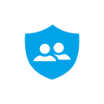
Considerations: Security
Get familiar with the Azure policies that will be inherited by the clusters
Decide whether the cluster's control plane should be accessible via the internet
Evaluate using the built-in AppArmor Linux security module
Evaluate using seccomp (secure computing) at the process level
Decide whether your container registry is accessible via the internet, or only within a specific virtual network.
Decide whether your private container registry will be shared across multiple landing zones or if you'll deploy a dedicated container registry to each landing zone subscription.
Consider using a security solution like Microsoft Defender for Kubernetes for threat detection.
Consider scanning your container images for vulnerabilities.
Consider disabling Microsoft Defender for servers in the AKS subscription if there are no non-AKS virtual machines, to avoid unnecessary costs.
Notes:
if you create an AKS cluster in a subscription deployed according to enterprise-scale landing zone best practices, get familiar with the Azure policies that will be inherited by the clusters, as described in Policies included in enterprise-scale landing zones reference implementations.
Decide whether the cluster's control plane should be accessible via the internet (in which case IP restrictions are recommended), which is the default, or only from within your private network in Azure or on-premises as a private cluster. Note that, as described in Policies included in enterprise-scale landing zones reference implementations, if your organization is following enterprise-scale landing zone best practices, the Corp management group will have an Azure Policy associated that forces clusters to be private.
Evaluate using the built-in AppArmor Linux security module to limit actions that containers can perform, like read, write, execute, or system functions like mounting file systems. For example, as described in Policies included in enterprise-scale landing zones reference implementations, all subscriptions will have Azure policies that prevent pods in all AKS clusters from creating privileged containers.
Evaluate using seccomp (secure computing) at the process level to limit the process calls that containers can perform. For example, the Azure Policy applied as part of the generic enterprise-scale landing zone implementation in the landing zones management group to prevent container privilege escalation to root uses seccomp through Azure policies for Kubernetes.
Decide whether your container registry is accessible via the internet, or only within a specific virtual network. Disabling internet access in a container registry can have negative effects on other systems that rely on public connectivity to access it, such as continuous integration pipelines or Microsoft Defender for image scanning. For more information, see Connect privately to a container registry using Azure Private Link.
Decide whether your private container registry will be shared across multiple landing zones or if you'll deploy a dedicated container registry to each landing zone subscription.
Consider using a security solution like Microsoft Defender for Kubernetes for threat detection.
Consider scanning your container images for vulnerabilities.
Consider disabling Microsoft Defender for servers in the AKS subscription if there are no non-AKS virtual machines, to avoid unnecessary costs.

Slide 21
Recommendation: Security
Limit access to the Kubernetes cluster configuration file by using Azure role-based access control.
Secure pod access to resources (least number of permissions and avoid root or privileged escalation)
Use pod-managed identities and Azure Key Vault provider for Secrets Store CSI Driver to protect secrets, certificates, and connection strings.
Use AKS node image upgrade to update AKS cluster node images or kured
Deploy a dedicated and private instance of Azure Container Registry to each landing zone subscription.
Use Private Link for Azure Container Registry to connect it to AKS.
Notes:
Limit access to the Kubernetes cluster configuration file by using Azure role-based access control.
Secure pod access to resources. Provide the least number of permissions, and avoid using root or privileged escalation.
Use pod-managed identities and Azure Key Vault provider for Secrets Store CSI Driver to protect secrets, certificates, and connection strings.
Use AKS node image upgrade to update AKS cluster node images if possible, or kured to automate node reboots after applying updates.
Deploy a dedicated and private instance of Azure Container Registry to each landing zone subscription.
Use Private Link for Azure Container Registry to connect it to AKS.

Slide 22
Design: Platform automation and DevOps for AKS
Consider the Azure service limitations and CI/CD environment in automation approach.
Consider security options from a CI/CD perspective (automatic deployments)
Consider using prefixes and suffixes with well-defined conventions to uniquely identify every deployed resource.
Inventory the workflows to support in engineering, updating, and deploying your solution in normal and Disaster Recovery Plan (DRP) regimes
Consider using a service mesh to add more security, encryption, and log capabilities to your workloads.
Consider deploying other resources like subscriptions, tagging, and labels to support your DevOps
Consider the impact of the cattle versus pets paradigm shift.
Don't rely on IP addresses or other resources to be fixed or permanent.
Notes:
Consider the Azure service limitations and your continuous integration and continuous delivery (CI/CD) environment when determining your engineering and automation approach. For another example, see the GitHub usage limitations.
When securing and protecting access to development, test, Q&A, and production environments, consider security options from a CI/CD perspective. Deployments happen automatically, so map access control accordingly.
Consider using prefixes and suffixes with well-defined conventions to uniquely identify every deployed resource. These naming conventions avoid conflicts in deploying solutions next to each other, and improve overall team agility and throughput.
Inventory the workflows to support in engineering, updating, and deploying your solution in normal and Disaster Recovery Plan (DRP) regimes. Consider mapping pipelines according to those workflows, maximizing familiarity and productivity.
Consider using a service mesh to add more security, encryption, and log capabilities to your workloads.
Consider deploying other resources like subscriptions, tagging, and labels to support your DevOps experience by tracking and tracing deployments and related artifacts.
Consider the impact of the cattle versus pets paradigm shift. Expect pods and other aspects of Kubernetes to be ephemeral, and align your automation and pipeline infrastructure accordingly. Don't rely on IP addresses or other resources to be fixed or permanent.

Slide 23

Recommendations: Platform automation and DevOps for AKS
Rely on pipelines or actions to maximize applied practices across the team, remove “reinvent the wheel” approach and provide predicatibility / insights
Deploy early and often by using trigger-based and scheduled pipelines - separate infrastructure deployment from application deployment.
Deploy using cloud-native options (IaC, operator pattern, helm) and use GitOps to deploy and maintain applications
Use pod-managed identities and Azure Key Vault provider (CSI Driver) to protect secrets, certificates, and connection strings (avoid hardcoded configuration items and settings).
Rely on well-known conventions across infrastructure and application-related deployments.
Embrace shift left consistently with security (add vulnerability scanning tools early in the pipeline) and use policy as code through admission controllers.
Treat every failure, error, or outage as an opportunity to automate and improve overall solution quality
Notes:
Rely on pipelines or actions to:
Maximize applied practices across the team.
Remove much of the burden of reinventing the wheel.
Provide predictability and insights in overall quality and agility.
Deploy early and often by using trigger-based and scheduled pipelines. Trigger-based pipelines ensure changes go through proper validation, while scheduled pipelines manage behavior in changing environments.
Separate infrastructure deployment from application deployment. Core infrastructure changes less than applications. Treat each type of deployment as a separate flow and pipeline.
Deploy using cloud-native options. Use infrastructure as code to deploy infrastructure including the control plane, and use Helm and the Operator pattern in Kubernetes to deploy and maintain Kubernetes native components.
Use GitOps to deploy and maintain applications. GitOps uses the Git repository as a single source of truth, avoiding configuration drift and increasing productivity and reliability during rollbacks and related procedures
Use pod-managed identities and Azure Key Vault provider for Secrets Store CSI Driver to protect secrets, certificates, and connection strings.
Strive for maximized deployment concurrency by avoiding hardcoded configuration items and settings.
Rely on well-known conventions across infrastructure and application-related deployments. Use admission controllers combined with the Azure Policy add-on for Kubernetes to validate and enforce conventions among the other defined policies.
Embrace shift left consistently with:
Security, by adding vulnerability scanning tools like container scanning early in the pipeline. Policy, by using policy as code and enforcing policies in a cloud-native manner through admission controllers.
Treat every failure, error, or outage as an opportunity to automate and improve overall solution quality. Integrate this approach in your shift left and site reliability engineering (SRE) framework.

Slide 24

Design: Scalability
Common questions:
Is rapid scalability a requirement for your application (no-time-to-wait)?
Is the workload non-time sensitive and can handle interruptions?
Is the underlying infrastructure (network plug-in, IP ranges, subscription limits, quotas, and so on) capable to scale out?
Consider to automate scalability with node pools (and multizones) and use VMSS
Use Azure Container Instances and virtual nodes for rapid and infinite scalability and per-second billing.
Use cluster auto-scaler and scale-to-zero for predictable scalability using VM-based worker nodes.
Enable horizontal pod auto-scaler (HPA) to mitigate the busy hours of your application.
Enable Azure Monitor for containers and live monitoring to monitor the cluster and workload utilization.
Consider Spot VM-based node pools for non-time-sensitive workloads
Notes:
To have a quick provisioning of pods use virtual nodes, they are only supported with Linux nodes/pods.
You can enable cluster autoscaling to scale the number of nodes. Consider cluster autoscaling and scale-to-zero
Horizontal pod autoscaler automatically scales the number of pods.
Consider scalability with multizone and node pools
When creating node pools consider to set Availability Zones with AKS.
Consider to use multiple node pools to support applications with different requirements.
Scale node pools with cluster autoscaler.
You can scale to zero the user node pools. See the limitations.
Is rapid scalability a requirement for your application (no-time-to-wait)?
Is the workload non-time sensitive and can handle interruptions? Consider the use of Spot VMs
Is the underlying infrastructure (network plug-in, IP ranges, subscription limits, quotas, and so on) capable to scale out?
Consider to automate scalability
Consider scalability with multizone and node pools
Use virtual machine scale sets (VMSS), which are required for scenarios including autoscaling, multiple node pools, and Windows node pool support.
If you need fast burst autoscaling choose to burst from AKS cluster using Azure Container Instances and virtual nodes for rapid and infinite scalability and per-second billing.
Use cluster autoscaler and scale-to-zero for predictable scalability using VM-based worker nodes.
Enable horizontal pod autoscaler (HPA) to mitigate the busy hours of your application.
Enable Azure Monitor for containers and live monitoring to monitor the cluster and workload utilization.
Use multiple node pools when your applications have different resource requirements
Consider Spot VM-based node pools for non-time-sensitive workloads that can handle interruptions and evictions.

Slide 25
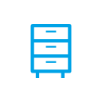
Design: Storage
Use Azure Private Link.
Use ephemeral disks for OS.
Use managed databases.
Azure Disk | Azure Files | Azure NetAppFiles | Azure Blob Storage
Use Premium or Ultra disks Size the node for disks and throughput. Create snapshots of persistent volumes. Avoid disk striping across disks. Use PV/PVC. | Choose Premium. Create dedicated storage accounts. Choose staticor dynamically created file shares. | Choose a performance tier based on the application requirements. Create capacity pools in the same Azure region as the AKS cluster Use the Auto QoS type for capacity pools. Plan your network | Use an SDK to interface with storage. Use CSI with NFS to interface with storage. Use Azure AD for access. Adjust tier levels.
Notes:
Use Azure Private Link. For security, we recommend using Azure Private Link for all storage solutions that support it. Azure Private Link enables access to Azure Services, such as Azure Storage and SQL Database, and Azure-hosted services over a private endpoint in your virtual network
Use ephemeral disks for OS. For OS disks, we recommend using ephemeral disks. To benefit from this feature, select a VM size that has an adequately sized temporary disk.
Use managed databases. For application data, we recommend using managed databases
Azure Disk:
Use Premium or Ultra disks. In most cases, we recommend Premium or Ultra disks to ensure adequate performance
Size the node for disks and throughput. We recommend ensuring that the size of your Kubernetes node is large enough to support the number of disks and the amount of aggregate throughput.
Create snapshots of persistent volumes. We recommend taking snapshots of persistent volumes, either to provision new volumes that are pre-populated with the snapshot data or to restore an existing volume to a previous state by using the snapshot capability of the Azure Disks CSI driver.
Avoid disk striping across disks. We recommend that you avoid striping across multiple disks in Kubernetes.
Use PV/PVC. We recommend using PV and PVC in Kubernetes to dynamically create disks where required.
Azure Files:
Choose Premium. If performance is critical, we recommend using the Premium tier.
Create dedicated storage accounts. We recommend providing dedicated storage accounts for your file shares.
Choose static or dynamically created file shares. We recommend careful consideration of whether you want AKS to create the file shares or if you want to create them statically outside of Kubernetes. Storage that is created dynamically can also be deleted dynamically
Azure Net App Files
Choose a performance tier based on the application requirements. Azure NetApp Files offers 3 performance tiers that offer varying classes of performance.
Create capacity pools in the same Azure region as the AKS cluster
Use the Auto QoS type for capacity pools.
Plan your network. Two options exist for network design:
- If you use the same VNet for AKS and Azure NetApp Files, create a dedicated subnet for Azure NetApp Files and delegate the subnet to Microsoft.NetApp/Volumes.
- If you use different VNets, establish VNet peering between them.
Azure Blob Storage:
Use an SDK to interface with storage. We recommend using an application-level SDK to interface with blob storage.
Use CSI with NFS to interface with storage. If you can't use an application-level SDK to interface with blob storage, we recommend using the NFS v3 option in the blob CSI driver.
Use Azure AD for access. We recommend using Azure AD for authorizing access to blob storage. Avoid using a shared storage account key.
Adjust tier levels. We recommend using lifecycle management policies to move infrequently accessed data to a cooler access tier.

Slide 26

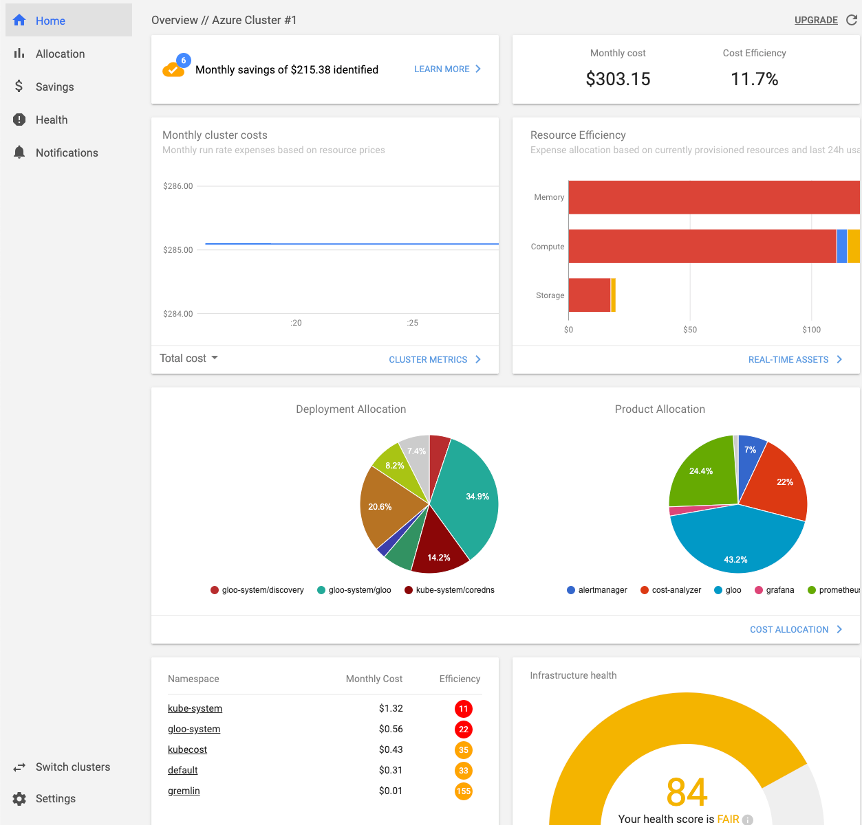
Cost governance with Kubecost
Enables break down in following categories:
Monthly cluster cost
Namespace cost
Deployment resource cost
Cost efficiency
Integrates with Azure - Azure Cloud Integration - Kubecost Documentation

Slide 27
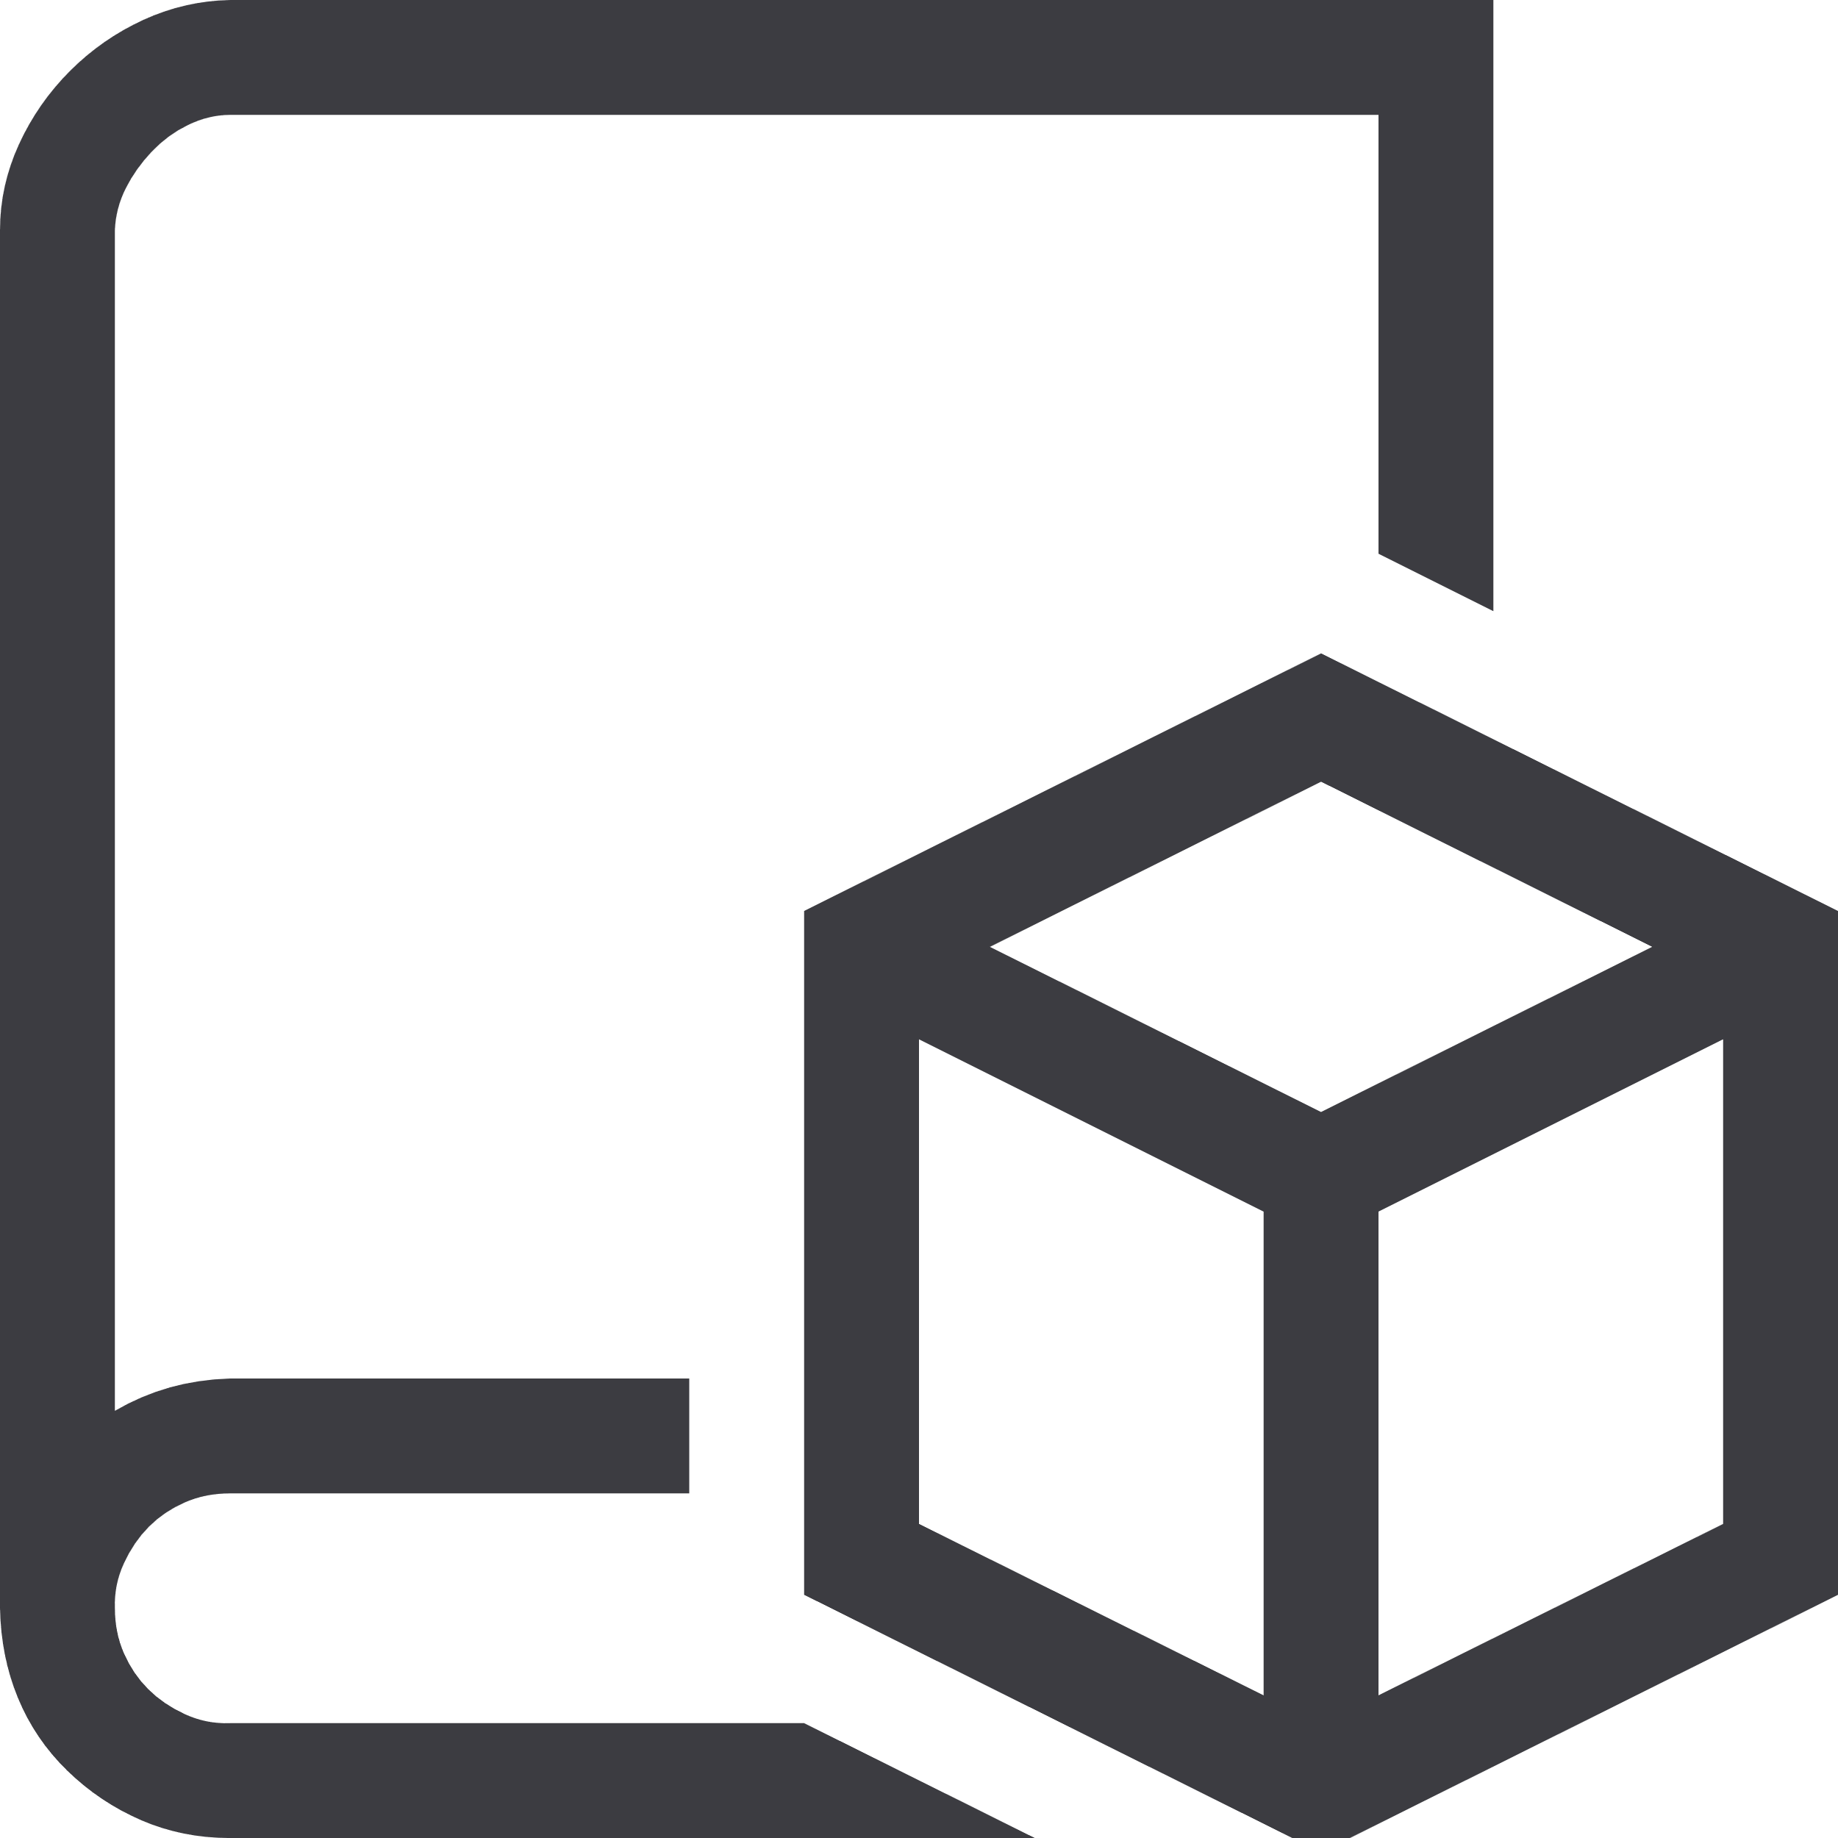
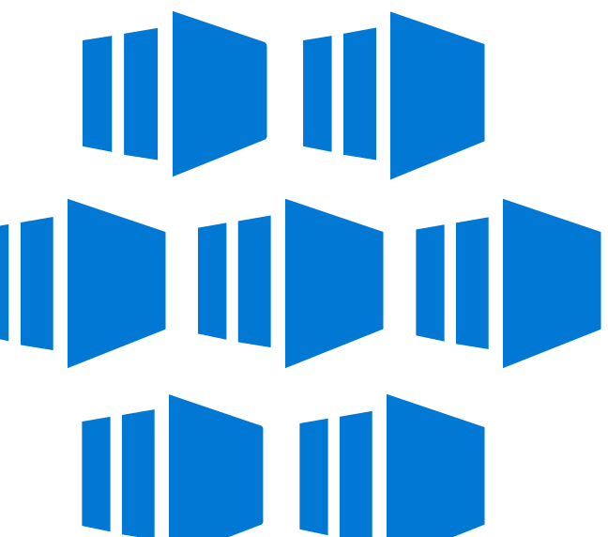






Best support for your enterprise needs
Container Adoption Best Practices aka.ms/adopt/containers
Kubernetes on Azure aka.ms/K8sonAzure
Learning path aka.ms/LearnKubernetes
What is Kubernetes aka.ms/k8sLearning
Hear from experts aka.ms/AKS/videos
Case studies aka.ms/AKS/casestudy
See what’s new aka.ms/k8sroadmap
Try for free aka.ms/AKS/trial

Slide 28
Thank you.

